Slide 1
Genetic Algorithm Continued
Lectures 9 and 10

Slide 2
Mutation
Mutation is a genetic operator used to maintain genetic diversity from one generation of a population to the next
Analogous to biological mutation
In GA, the concept of biological mutation is modelled artificially to bring a local change over the current solutions.

Slide 3
Mutation Operation in GAs
Binary-Coded GAs: Flipping
Real-Coded GAs
Random Mutation
Polynomial Mutation

Slide 4
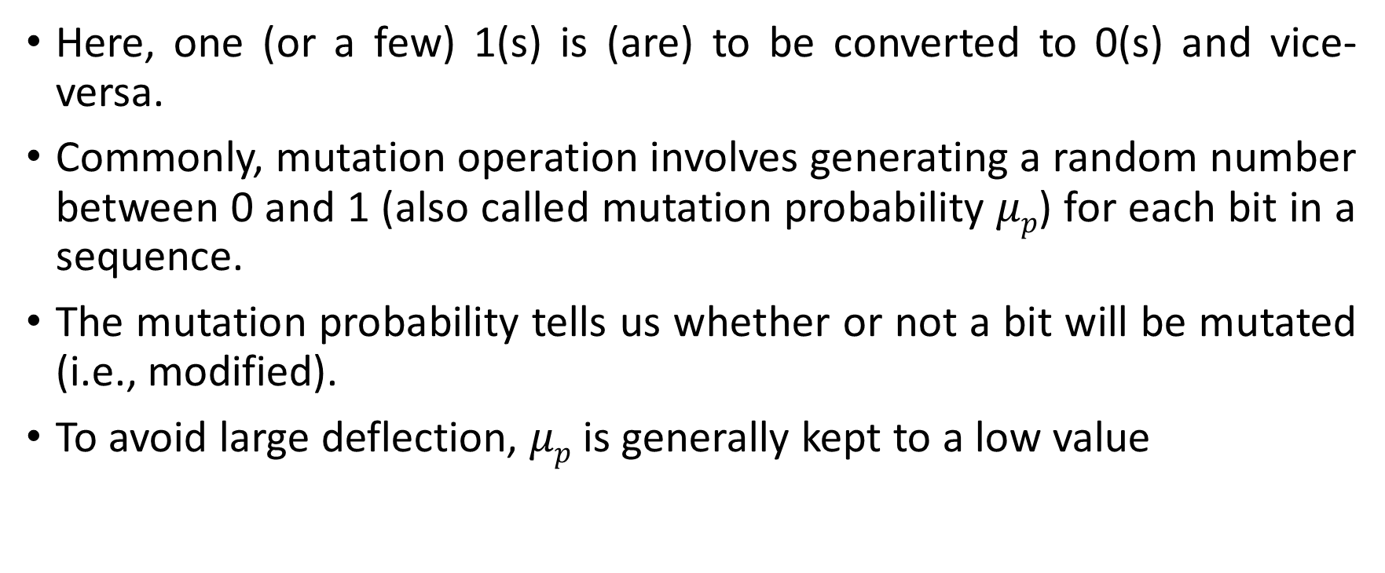
Mutation Operation in Binary-Coded GAs
Here, one (or a few) 1(s) is (are) to be converted to 0(s) and vice-versa.
Commonly, mutation operation involves generating a random number between 0 and 1 (also called mutation probability $μp$) for each bit in a sequence.
The mutation probability tells us whether or not a bit will be mutated (i.e., modified).
To avoid large deflection, $μp$ is generally kept to a low value

Slide 5
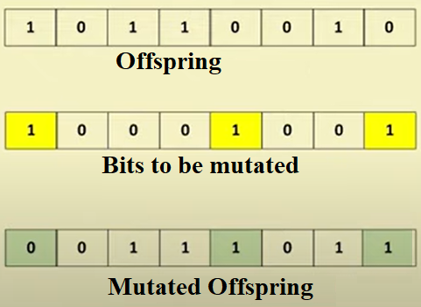
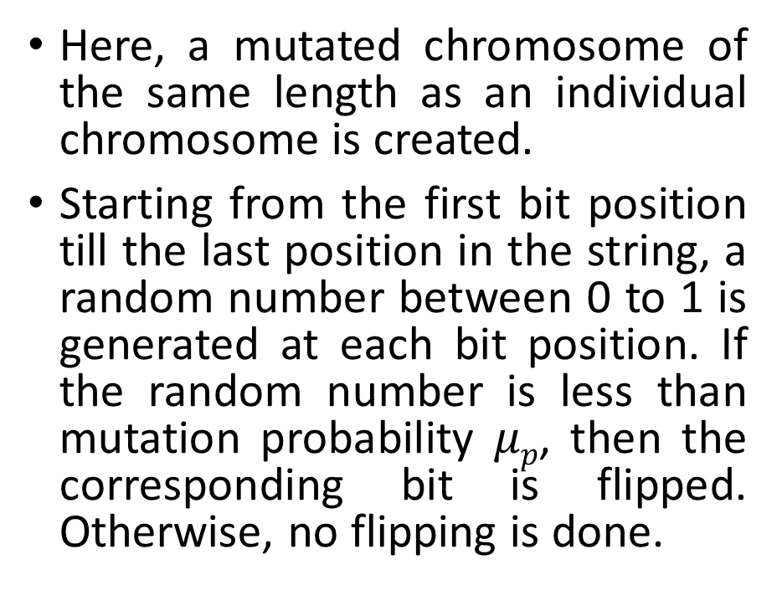
Mutation Operation in Binary-Coded GAs: Flipping
Here, a mutated chromosome of the same length as an individual chromosome is created.
Starting from the first bit position till the last position in the string, a random number between 0 to 1 is generated at each bit position. If the random number is less than mutation probability $μp$, then the corresponding bit is flipped. Otherwise, no flipping is done.

Slide 6
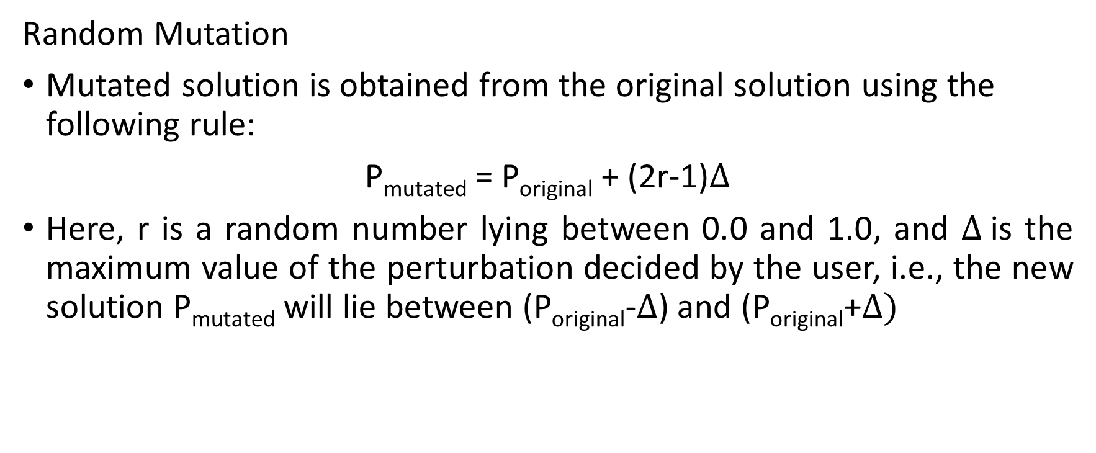
Mutation Operation in Real-Coded GAs
Random Mutation
Mutated solution is obtained from the original solution using the following rule:
P_{mutated} = P_{original} + (2r-1)$∆$
Here, r is a random number lying between 0.0 and 1.0, and $∆$is the maximum value of the perturbation decided by the user, i.e., the new solution P_{mutated} will lie between (P_{original}-$∆$) and (P_{original}+$∆)$

Slide 7
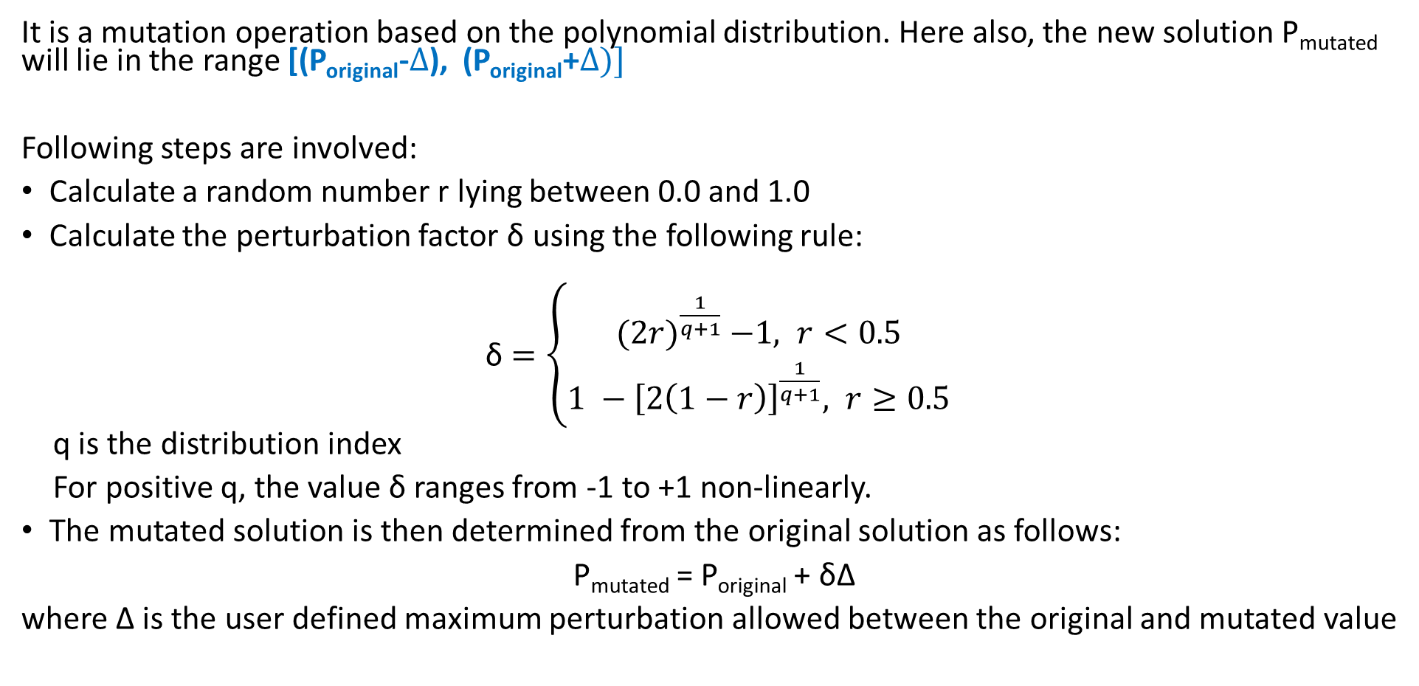
Mutation in Real-Coded GAs: Polynomial Mutation
It is a mutation operation based on the polynomial distribution. Here also, the new solution P_{mutated} will lie in the range [(P_{original}-$∆$), (P_{original}+$∆)]$
Following steps are involved:
Calculate a random number r lying between 0.0 and 1.0
Calculate the perturbation factor δ using the following rule:
δ $=\left\{\begin{aligned}{(2r)}^{\frac{1}{q+1}} −1, r<0.5 \\ &{1 −\left[2\left(1−r\right)\right]}^{\frac{1}{q+1}}, r≥0.5\end{aligned}\right.$
q is the distribution index
For positive q, the value δ ranges from -1 to +1 non-linearly.
The mutated solution is then determined from the original solution as follows:
P_{mutated} = P_{original} + δ∆
where ∆ is the user defined maximum perturbation allowed between the original and mutated value

Slide 8
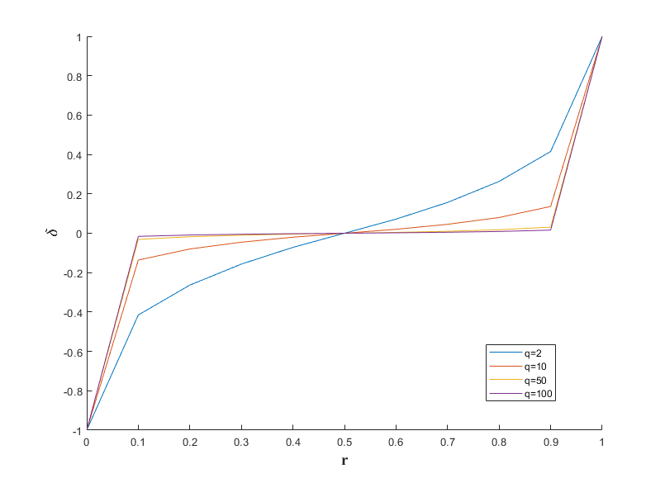
Mutation in Real-Coded GAs: Polynomial Mutation
q=0 makes the curve linear
Higher values of q continue to flatten the curve
Can you comment on how choice of δ affects the mutation?

Slide 9
Termination/Convergence Criteria
After completion of each iteration (selection, crossover, mutation) do a convergence test to check whether to run the next iteration or not.
Commonly used convergence criteria are:
A solution is found that satisfies the objective criteria
Fixed number of iterations is executed
Allocated budget (such as computation time) reached
The highest ranking solution fitness is reached, or the population of solutions has reached a plateau, and successive iterations no longer produce better results
Manual inspection
Combination of the above

Slide 10
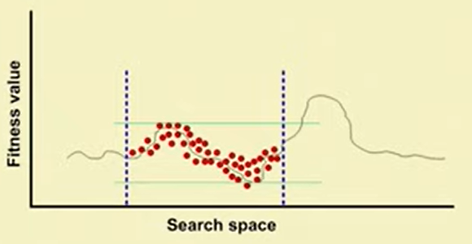
Fitness Scaling in GAs
Case 1: Fitness values are within a narrow range.
Population average fitness is almost same as the population maximum fitness. Commonly encountered in the mature phase of GA
Successive iterations will not show any improvement and hence GA gets stuck at local optima
If this situation is left alone, average members and best members get nearly the same number of copies in the future generations.
Survival of the fittest necessarily becomes a random walk among the mediocre.

Slide 11
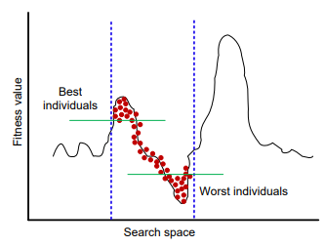
Fitness Scaling in GAs
Case 2: Fitness values are too far apart (i.e., the range is high)
Commonly encountered during the initial phases of the GA
In this case, any proportionate selection scheme in GA tends to select higher number of copies of the good individual and many other worse individuals do not get selected.
This will tend to generate the new population with very similar chromosomes, thereby limiting the ability of the GA to explore large amount of search space.
This is undesirable, and a leading cause for premature convergence.
In both cases, fitness scaling can help.

Slide 12
Linear Scaling
Simple and useful scaling technique
If raw fitness value is denote by f and scaled fitness value by f’, then linear scaling requires a linear relationship between f and f’ as follows:
f’ = af+b
Coefficients a and b may be chosen in several ways. However, in all cases our aim is to scale the fitness values such that the average fitness before and after scaling remains the same, i.e., f’_{avg} = f_{avg}
This ensures each average population member contributes one expected offspring in the next generation.

Slide 13
Linear Scaling
To control the number of offspring given to a population member with maximum raw fitness, we employ the following linear scaling relationship:
f’_{max} = C_{mult}*f_{avg}
Here, C_{mult} is the number of expected copies of the population member with maximum fitness value.
Note that, this helps in avoiding the domination of highly fit (super) individuals
For typical small populations (n=50 to 100), C_{mult}= 1.2 to 2 has been seen to be successful

Slide 14
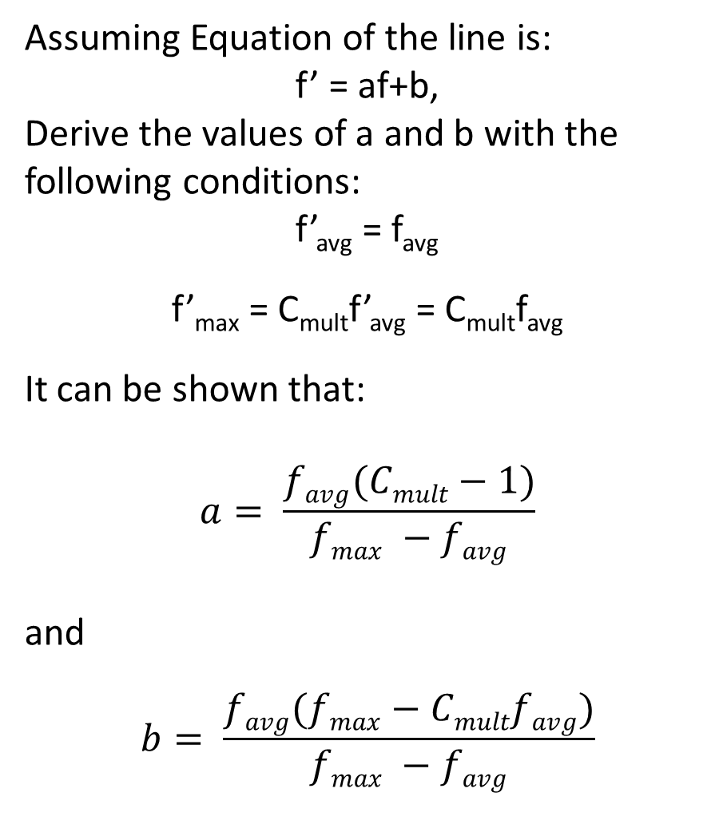
Linear Scaling in Initial Iterations
Assuming Equation of the line is:
f’ = af+b,
Derive the values of a and b with the following conditions:
f’_{avg} = f_{avg}
f’_{max} = C_{mult}f’_{avg} = C_{mult}f_{avg}
It can be shown that:
$$a= \frac{favg(Cmult−1)}{fmax −favg}$$
and
$$b= \frac{favg(fmax−Cmultfavg)}{fmax −favg}$$
f’_{max}
f’_{avg}
SCALED FITNESS
f’_{min}
f_{min}
f_{avg}
f_{max}
RAW FITNESS

Slide 15
Linear Scaling in Mature Phases
f’_{max}
In the initial phases of the GA, fitness scaling helps by reducing the dominance of a few highly-fit individuals.
However, a problem arises in the mature phases of GA when the algorithm achieves near-convergence.
At this time, the average fitness becomes higher and mover closer to the maximum fitness.
As a result, in the plot the distance between f_{avg} and f_{max} reduces.
The stretching required on the relatively close average and maximum fitness values causes f’_{min} to go negative as shown in the figure.
Several options are available to tackle this problem:
In the mature phases of the GA, donot scale f’_{max} to C_{mult}f_{avg.} Rather perform the scaling by pivoting around the average value, and stretching the fitness until the minimum value maps to zero.
Perform sigma-truncation
f’_{avg}
SCALED FITNESS
f_{min}
f_{avg}
f_{max}
RAW FITNESS
f’_{min}

Slide 16
Linear Scaling
f’_{max}
During the initial iterations of GA, f’_{min} will be most likely greater than zero. Hence, use the linear scaling function f’ = af+b with a and b values as derived in Slide 14.
In the final stages of GA, a few scaled fitness values are likely to become negative. In that case we will use a different scaling function such that f’_{max} is not C_{mult} times f_{avg}. Refer to the next slide
f’_{avg}
SCALED FITNESS
f_{min}
f_{avg}
f_{max}
RAW FITNESS
f’_{min}

Slide 17
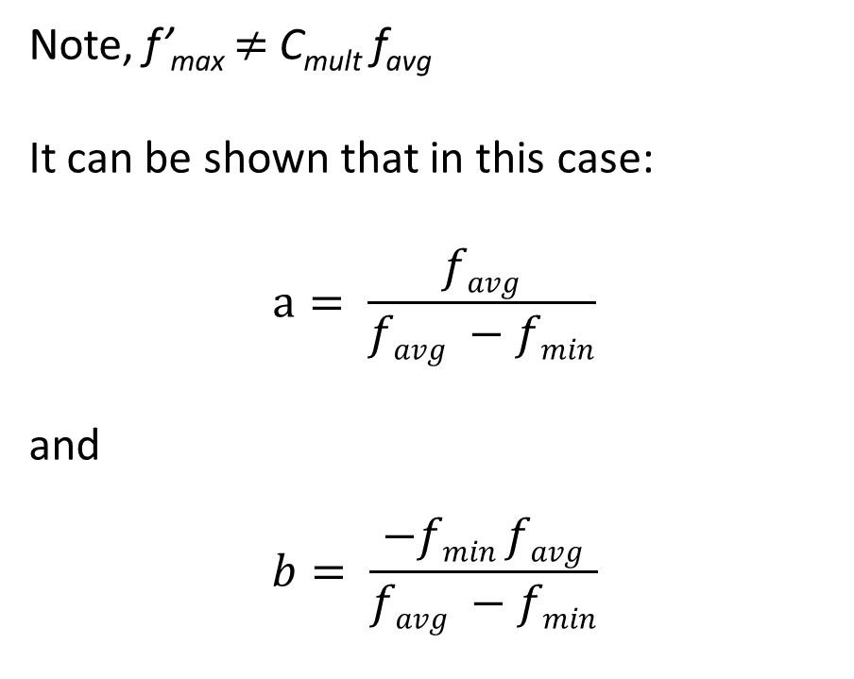
Linear Scaling in Mature Phases
C_{mult}f_{avg}
Note, f’_{max} $≠$ C_{mult} f_{avg}
It can be shown that in this case:
$$a= \frac{favg}{favg −fmin}$$
and
$$b= \frac{−fmin favg}{favg −fmin}$$
f’_{max}
f’_{avg}
SCALED FITNESS
f’_{min}=0
f_{min}
f_{avg}
f_{max}
RAW FITNESS
Note that, individuals with the least fitness value do not stand a chance of getting selected in the mating pool and participate in the reproduction process. However, some individuals with fitness value less than average get their fitness values scaled up which increases their chance of getting selected in the mating pool. This helps in creating more diversity in the population.

Slide 18




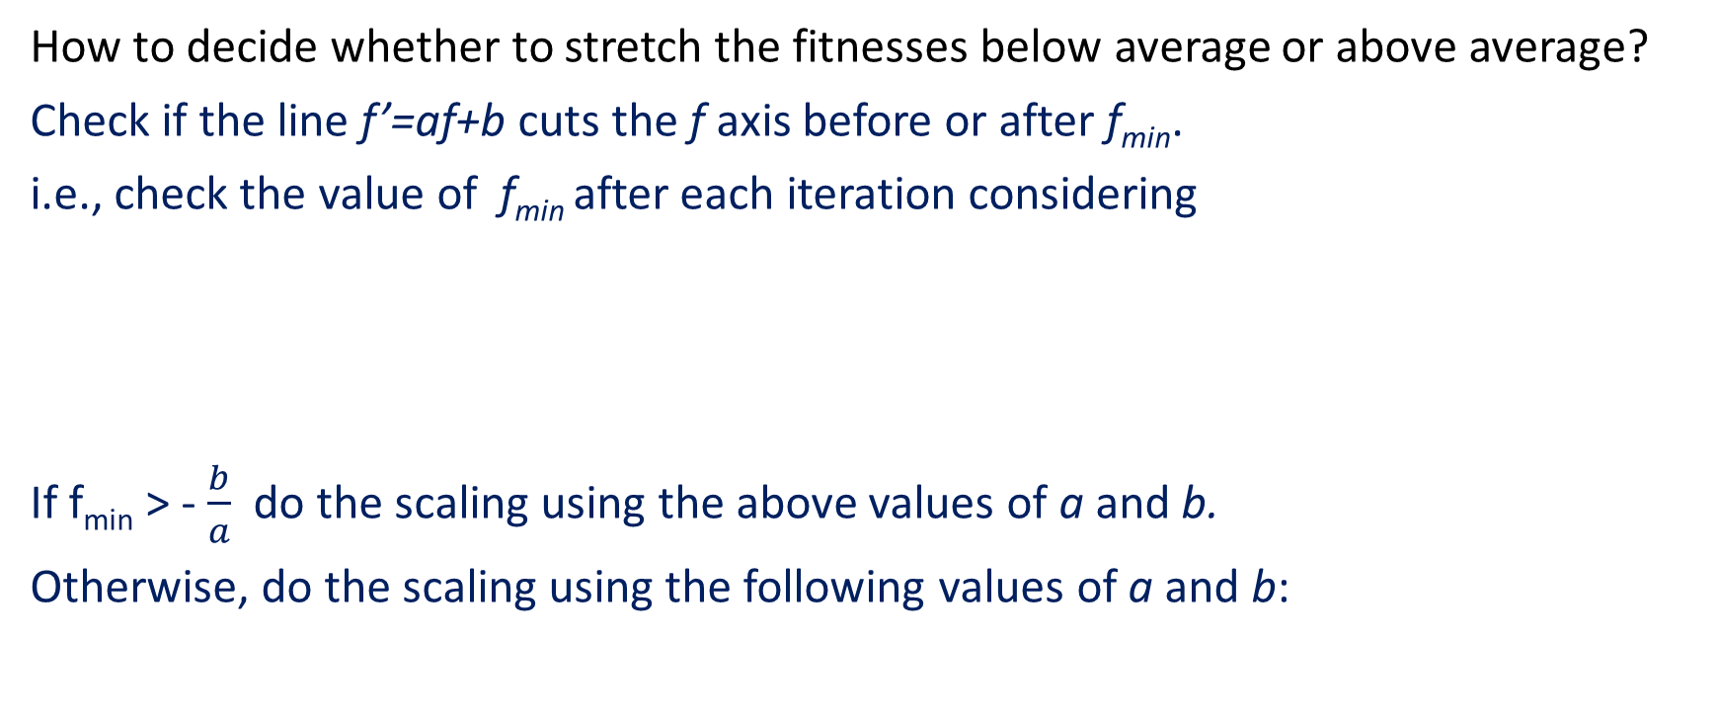
Linear Scaling
How to decide whether to stretch the fitnesses below average or above average?
Check if the line f’=af+b cuts the f axis before or after f_{min}.
i.e., check the value of f_{min} after each iteration considering
If f_{min} > - $\frac{b}{a}$ do the scaling using the above values of a and b.
Otherwise, do the scaling using the following values of a and b:
and
and

Slide 19
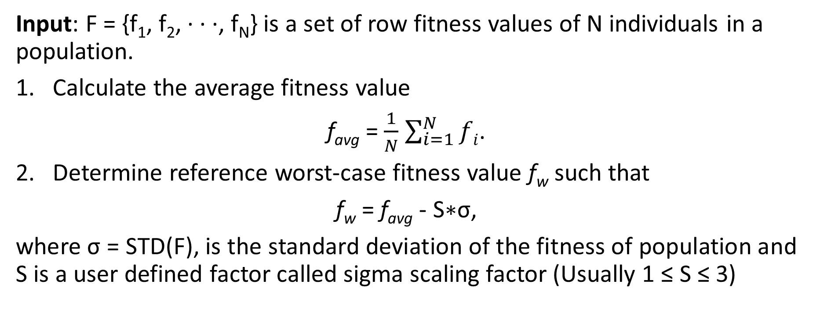
Sigma Scaling/Sigma Truncation
Input: F = {f₁, f₂, · · ·, f_{N}} is a set of row fitness values of N individuals in a population.
Calculate the average fitness value
f_{avg} = $\frac{1}{N}$ $\sum_{i=1}^{N}{fi}$.
Determine reference worst-case fitness value f_{w} such that
f_{w} = f_{avg} - S∗σ,
where σ = STD(F), is the standard deviation of the fitness of population and S is a user defined factor called sigma scaling factor (Usually 1 ≤ S ≤ 3)

Slide 20
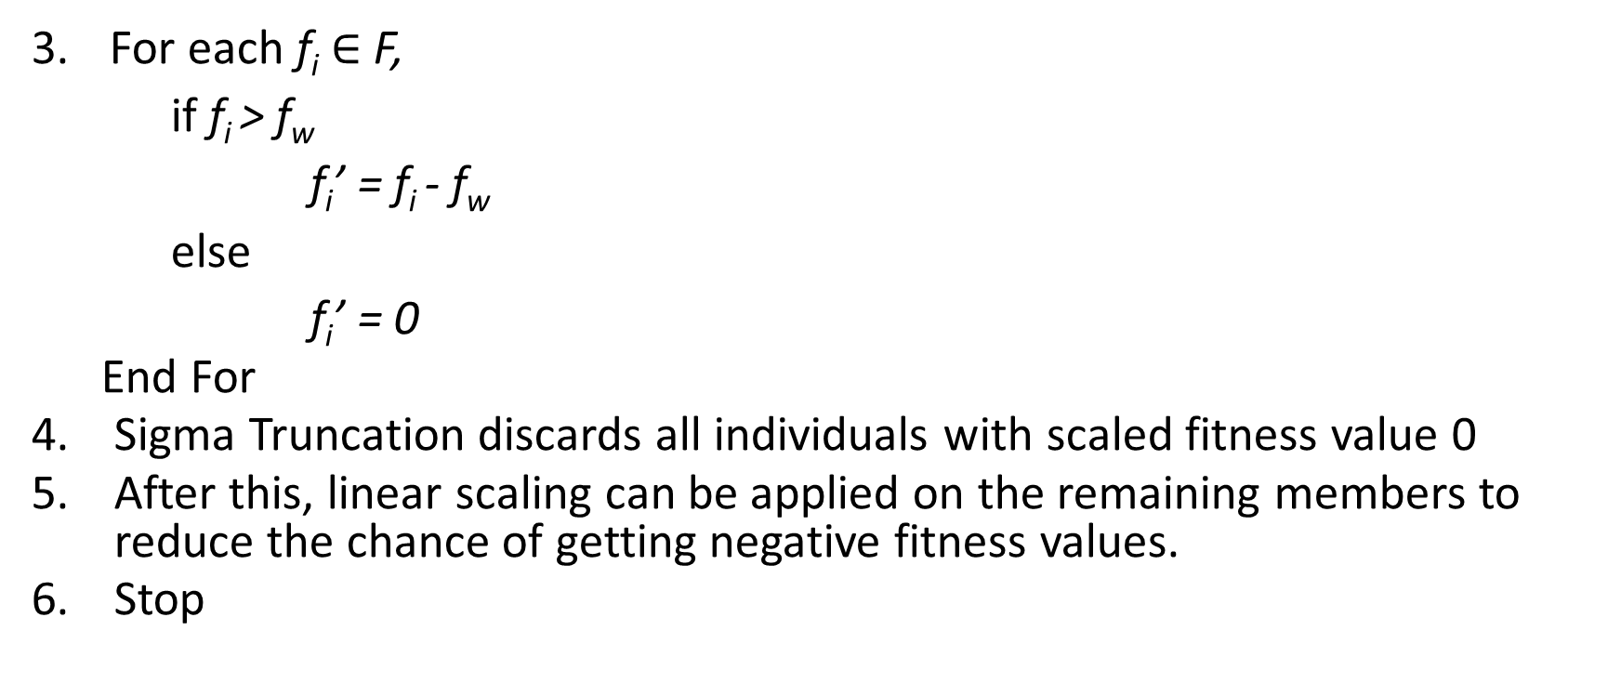
Sigma Scaling
For each f_{i} $∈$ F,
if f_{i} > f_{w}
f_{i}’ = f_{i} - f_{w}
else
f_{i}’ = 0
End For
Sigma Truncation discards all individuals with scaled fitness value 0
After this, linear scaling can be applied on the remaining members to reduce the chance of getting negative fitness values.
Stop
Note: At the initial iterations, f_{w} is low, and therefore fitness values do not change much by sigma scaling. At the mature phases of the GA, the f_{avg} increases, and also σ reduces thereby increasing the value of f_{w}. This causes weak individuals to get discarded and prevent the linear scaling to produce negative fitness values.

Slide 21
THANK YOU

